Slide 1
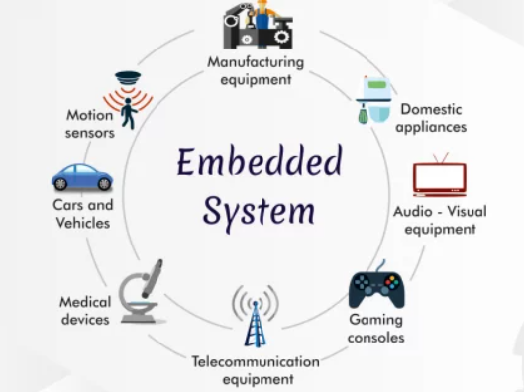
Electronics and Embedded Systems Course
Comprehensive Curriculum

Slide 2

Overview
Introductory Session: Electronics and Embedded Systems
Circuit Analysis, Instrument Measurement, and Tools
Ohms law, voltage divider, opto-coupler, led-driver, BJT-MOSFET switch design, ESD, Voltage regulators and power supply.
Schematic capture and simulations, easyeda login
Communications & Protocols
UART-RS-323, RS-485, I2C, SPI, ONE WIRE, SIM, LTE, BLE, Zigbee, LoRa etc.
Introduction to ESP32: Hardware-Related Programming Environment
Arduino - IDE

Slide 3
Overview
Input-Output Devices, Sensors, and Actuators.
All sensors available in market, gps, magnetometer, loadcells, thermocouples.
DC, BLDC motors, solenoids, relays.
IoT with Arduino + ESP32 Core few weeks.
Hardware design and development.
Industrial automation.
Embedded systems using C/C++.
Android for user interface.
Web development for dashboard.
PCB Design, Machinery, and Processing.
Prototype and 3D Printing.

Slide 4
Weekly Structure
Point 1: Assignment (15-min)
Point 2: Main Course Content (Middle Hours)
Point 3: Q/A, Task Assignment and Discussion (Last 15-min)
Online Assignments

Slide 5

Course Duration
4 Hours Per Week
Online 4hours once a week 9:00am-1:00pm.
Total of 12 Weeks 48-hours

Slide 6
Day-1 (zoom meeting)
Introductory Session:
IoT Big Picture: Sir Suhail (2 hours).
Electronics and Embedded Systems: Sir Azmat (1 hour).
Face Time With Students (30-min).
Course Objectives: Dr. Aamir (30-min).

Slide 7
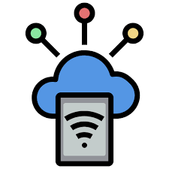
IoT SPRING’24
INTRODUCTION TO
INTERNET OF THINGS

Slide 8
Contents
History of Innovation Cycles
What is IoT & Why it is needed
IoT cycle & How does IoT works
IoT Components, Categories, Uses & Risks
IoT Network & Connectivity Options
IoT Applications and Smart Solutions

Slide 9
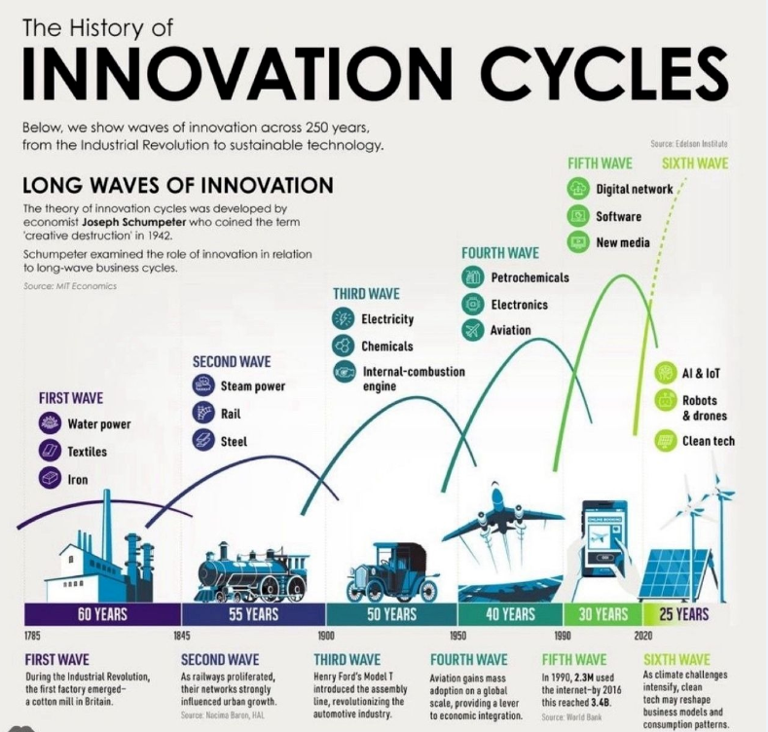

Slide 10
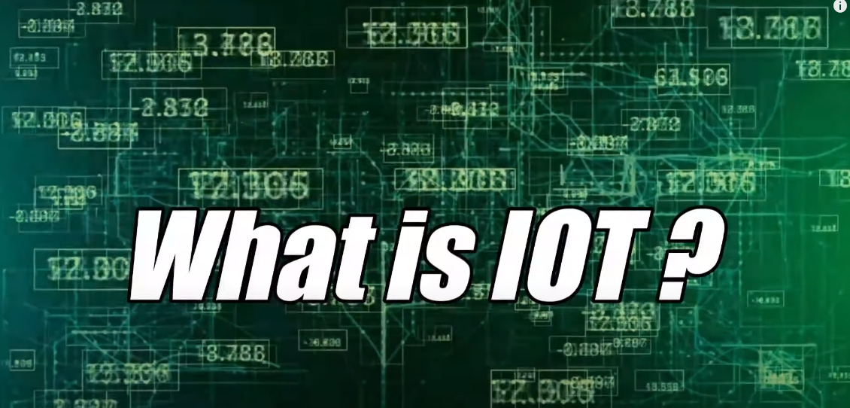
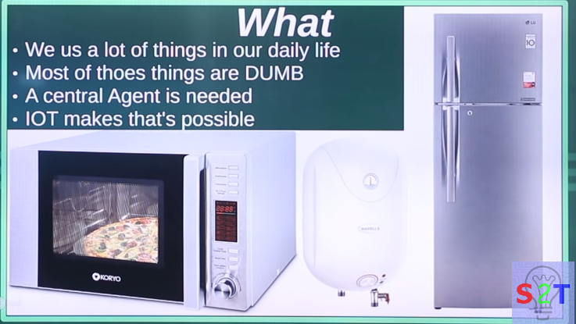

IoT SPRING’24
We use a lot of things in our daily life
Most of those things are DUMB
A central agent is needed
IoT makes that’s possible

Slide 11
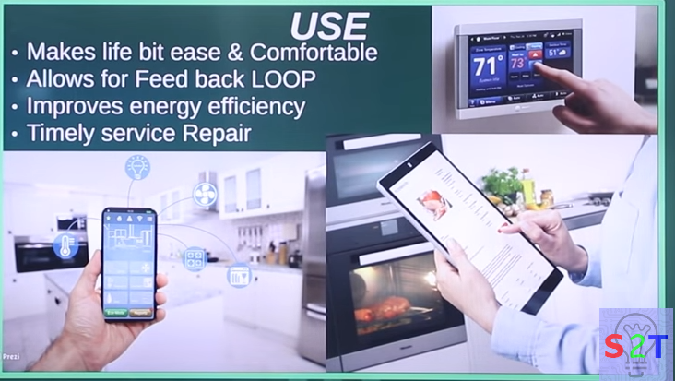
USES
Remote monitoring of devices
Makes life a bit easier & more comfortable
Allows for feedback loop.
Improves energy efficiency.
Timely service repair.

Slide 12
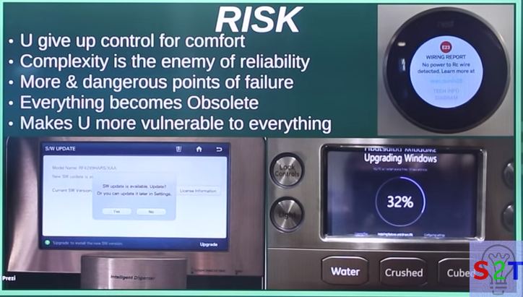
RISKS
You are giving up control for comfort
Complexity being the enemy of reliability
More and dangerous points of failure
Everything becoming obsolete
Makes you more vulnerable to everything

Slide 13
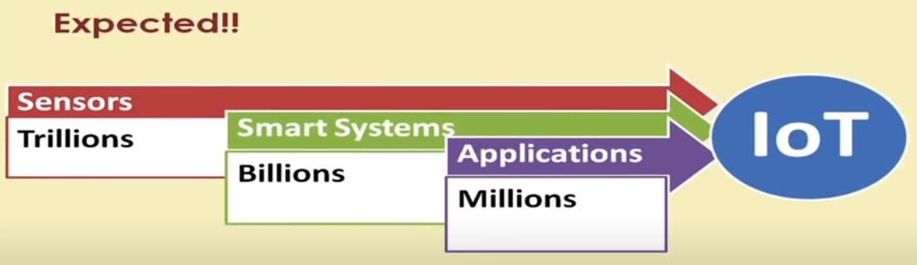
Who invented IoT ?
In 1999 Kevin Ashton invented the concept of the internet of things
The number of IoT devices available has grown from zero to around 27 billion.
Today, connectivity options include proprietary and cellular wireless transceivers that broadcast data to IoT devices a few feet or a few miles away and satellites that transmit data from orbit.

Slide 14
IoT Cycle
Devices
Connectivity
Any device
Any body
Any where
Any Business
Any Network
Any time
User Interface
Data Process

Slide 15
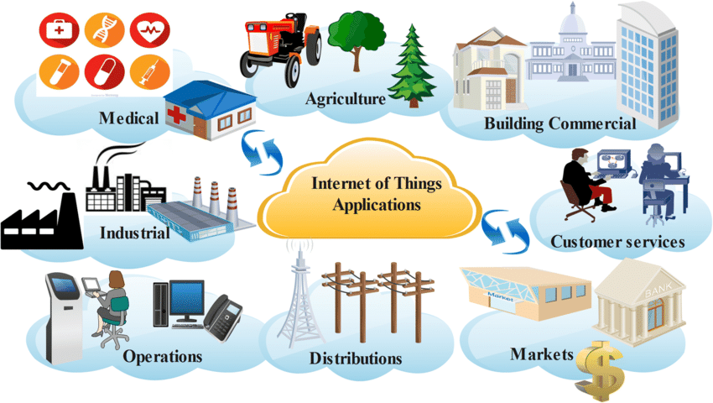
IoT Examples

Slide 16
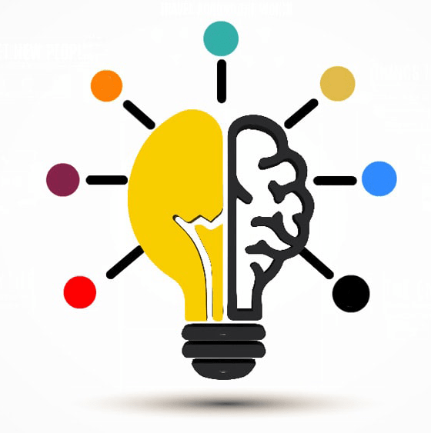
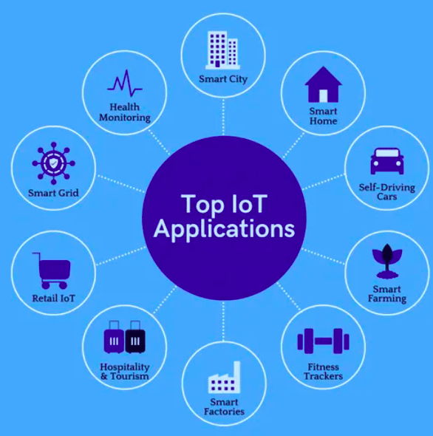
IoT Applications

Slide 17
IoT Applications
Agriculture:
Automates farming processes using IoT to overcome rural labor shortages and ensure efficient agricultural development.
Consumer Applications:
Enhances daily life with IoT-enabled devices like electronics, watches, and health trackers, contributing to a diverse market for lifestyle management.
Healthcare:
Utilizes wearable IoT devices for remote patient monitoring, collecting essential health data and benefiting both patients and healthcare providers.
Insurance:
Disrupts traditional insurance models with streamlined claim processes, reduced costs, and additional revenue through IoT-enabled digital networking.

Slide 18
IoT Applications
Manufacturing:
Creates a technically-driven environment by automating development cycles, optimizing production flow, and efficiently managing inventories.
Retail:
Uses IoT devices to gather and analyze data on product shopping lifecycles, enabling informed decisions for improving retail operations and enhancing the customer experience.
Transportation:
Integrates personal and commercial vehicles with IoT applications for route optimization, tracking, weather monitoring, and efficient information distribution.
Utilities/Energy:
Implements IoT in utility grids with intelligent meters and sensors, optimizing energy distribution, improving efficiency, and conserving resources.

Slide 19
IoT Applications
Traffic Monitoring:
Enhances urban decision-making with IoT-based traffic monitoring systems, providing real-time updates on incidents and congestion to save commute time.
Hospitality:
Utilizes IoT for centralized control in hotels, managing air conditioning, heating, and ventilation, along with devices alerting staff about appliance status for proactive maintenance.

Slide 20
IoT Components
Device The Thing
Local Network
Internet
Backend Services
Applications

Slide 21
How does IoT work ?
Internet of Things platform
An IoT platform manages device connectivity. It can be a software suite or a cloud service. The purpose of an IoT platform is to manage and monitor hardware, software, processing abilities, and application layers.
Sensor technologies
IoT sensors, sometimes called smart sensors, convert real-world variables into data that devices can interpret and share. Many different types of sensors exist. For example, temperature sensors detect heat and convert temperature changes into data. Motion sensors detect movement by monitoring ultrasonic waves and triggering a desired action when those waves are interrupted.
Unique identifiers
The core concept of the IoT is communication among devices and users. Unique identifiers (UIDs) establish the context of a device within the larger network to enable this communication. Identifiers are patterns, like numeric or alphanumeric strings. One example of a UID that you might be familiar with is an internet protocol (IP) address. They can identify a single device (instance identifier) or the class to which that device belongs (type identifier).

Slide 22
How does IoT work?
Internet connectivity
Sensors can connect to cloud platforms and other devices through a host of network protocols for the internet. This enables communication between devices.
Artificial intelligence (AI) and machine learning
Natural language processing (NLP) in IoT devices makes it easier for users to input information and interact with devices. One common example of an IoT device that utilizes NLP technology is the Amazon Alexa. Machine learning also enhances the analytical capabilities of IoT devices.
Edge computing
Edge computing is a computing framework. It aims to conserve resources and speed up response time by moving computational resources like data storage closer to the data source. The IoT accomplishes this by utilizing edge devices like IoT gateways.

Slide 23
Features of IoT
Connectivity: Establishes communication between diverse devices via radio waves, Wi-Fi, Bluetooth, or wires, linking IoT with cloud computing, AI, and blockchain.
Scaling: Adapts device numbers dynamically based on demand for optimal system performance.
Sensing: Uses sensors for environmental data (temperature, light, sound) to automate decision-making.
Analyzing: Processes raw data through AI for meaningful insights and improved functionality.
Artificial Intelligence: Integrates machine learning models for devices to understand and adapt to surroundings.
Smaller Devices: Compact semiconductor chips and sensors deliver precision and performance.
Dynamic Nature: Adapts to environmental changes, e.g., smart air conditioners adjusting based on sensor data.
Active Engagement: Connects devices with cloud computing, AI, and block chain for collaborative data manipulation.

Slide 24
Features Of IoT
Smaller Devices: Employs compact devices like semiconductor chips and sensors to efficiently deliver precision and performance, enhancing overall quality of living.
Dynamic Nature: Adapts to changes in the environment, exemplified by a smart air conditioner adjusting temperature and humidity based on real-time sensor data.
Active Engagement: Connects devices with technologies like cloud computing, AI, and block chain, fostering collaboration for data manipulation and business use.
Integration: Combines cross-domain technologies like cloud computing, AI, big data, and deep learning into an interconnected ecosystem, evolving from IoT to the "internet of everything."
Automated: Emphasizes automation to simplify life and business processes, such as IoT farming systems automating irrigation to reduce water wastage.
Security: Prioritizes robust security measures to safeguard sensitive information stored and transmitted within IoT systems, ensuring user trust and demand.
Endpoint Management: Crucial for successful IoT implementation, managing endpoints to prevent system failures, such as unnecessary grocery orders in the absence of users.

Slide 25
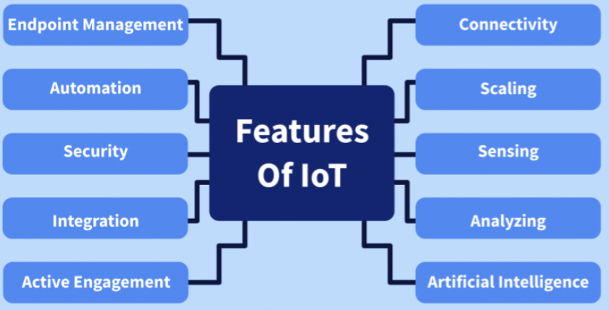
Features Of An IoT

Slide 26
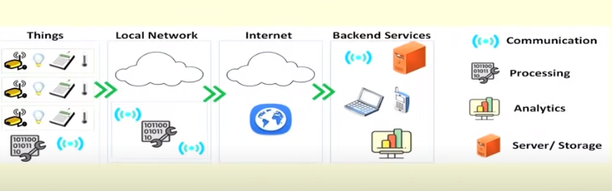
Scenarios Of An IoT

Slide 27
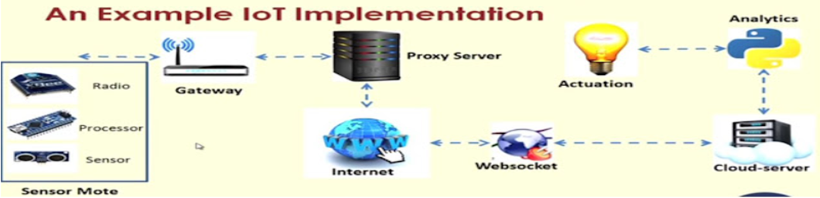
IoT Components
Component for interaction and communication with other IoT devices
Component for processing and analysis of operations
Component for Internet interaction
Component for handling Web services of applications
Component to integrate application services
User interface to access IoT

Slide 28
IoT Categories
Industrial IoT
IoT device connects to an IP network and the global network.
Communication between the nodes done using regular as well as industry specific technologies.
Consumer IoT
IoT device communicates with in the locally networked devices.
Local communication is done mainly via Bluetooth, Zigbee or Wifi.
Generally limited to local communication by a Gateway.

Slide 29
IoT Challenges
Security
Interfacing
Scalability
Interoperability
Energy efficiency
Data storage
Bandwidth management
Data Analytics
Modeling and Analysis
Complexity management (e.g., SDN)

Slide 30
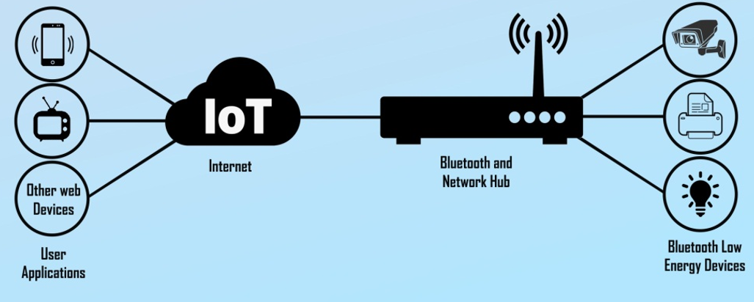
Considerations
Communication between the IoT devices and the outside world dictates the network architecture.
Choice of communication technology dictates the IoT device hardware requirements and costs.
Due to the presence of numerous applications of IoT enabled devices, a single networking paradigm not sufficient to address all the needs of the consumer or the IoT device.

Slide 31
Complexity of Networks
Growth of Networks
Interference among devices
Network management
Heterogeneity in the networks
Protocols standardization within networks

Slide 32
Wireless Networks
Traffic and load management
Variations in wireless networks – Wireless Body Area Networks and other Personal Area Networks
Interoperability
Network management
Overlay networks
Scalability
Flexibility within internet
IoT integration
Large scale deployment
Real-time connectivity of billions of devices

Slide 33

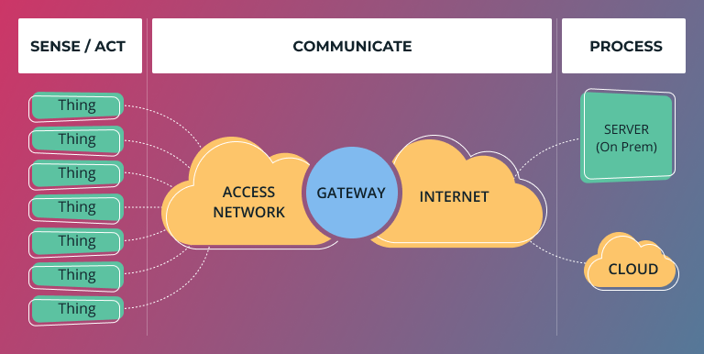
RISKS
The Internet of Things (IoT) introduces specific risks and challenges due to the interconnected nature of devices and the massive amounts of data they generate. Some of the key risks associated with IoT include.
Security Risks:
IoT devices may become targets for cyberattacks, leading to unauthorized access, data breaches, or manipulation of device functionalities. Insecure communication channels, weak authentication, and inadequate encryption can contribute to security vulnerabilities.
Privacy Concerns:
The extensive data collection capabilities of IoT devices raise privacy concerns. Personal and sensitive information may be collected without proper consent, leading to potential misuse or unauthorized access to individuals' data.

Slide 34

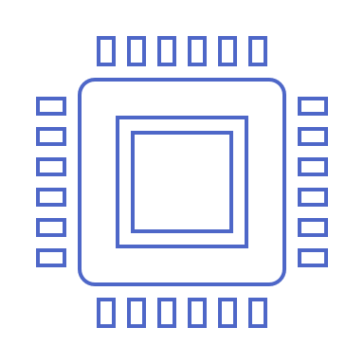
IOT ESSENTIALS
AN Introduction
ELECTRONICS AND EMBEDDED SYSTEMS
Azmat

Slide 35
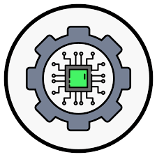
Internet Of Things
OVERVIEW OF ELECTRONICS
Unlocking the world of Electronics

Slide 36

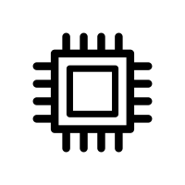

Agenda
Overview of Electronics
Definitions, Role of Electronics, Applications, and Basic Components
Introduction to Embedded Systems
Definitions, Role of Embedded Systems and Applications, Components of Embedded Systems and the mix of Electronics and Embedded Systems
Recap and Q&A
Recap with some basic quiz questions and Q&A

Slide 37

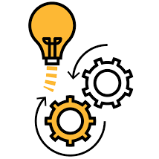
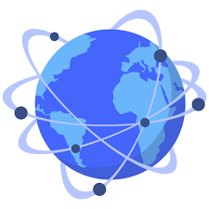
ROLE OF ELECTRONICS
Information Processing
Embedded systems automate specific functions within devices, streamlining processes and enhancing efficiency. For example, they control the timing and execution of tasks in a car's engine management system.
Enabling Modern Life
They enable instantaneous responses to external stimuli, crucial for applications like anti-lock braking systems in vehicles, ensuring precise and timely interventions for enhanced safety.
Connected World
Electronics play a pivotal role in pioneering smart solutions, connecting devices, and shaping a seamlessly integrated and interconnected world.

Slide 38


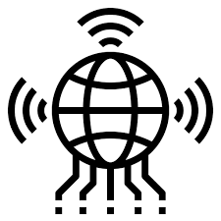
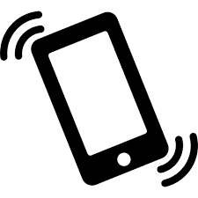
Electronics Used Everywhere!
Medical
4
Precision healthcare, remote monitoring
Electric Vehicles
Sustainable mobility
revolution
3
Smartphones
Information processing at your fingertips
2
IoT
Enabling a modern life-style
1

Slide 39
BASIC COMPONENTS
Voltage and current sources
Diodes, Transistors and ICs
Resistors, Capacitors and Inductors
Controlling the flow of Electrons
Switches
Active Components
Sources
Passive Components
Reference point for Voltage Level
Ground

Slide 40
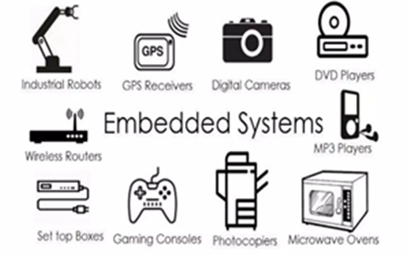
What is an Embedded System ?
An embedded system is an electronic/electro-mechanical system designed to perform a specific function and a combination of hardware and firmware (software).
Every embedded system is unique and the hardware as well as the firmware is highly specialized to the application domain.
Embedded system are becoming an inevitable part of any product or equipment, industrial control, consumer products, etc.

Slide 41
EMBEDDED SYSTEMS
INTRO TO
EMBEDDED SYSTEMS
Exploring the heart of Technology

Slide 42
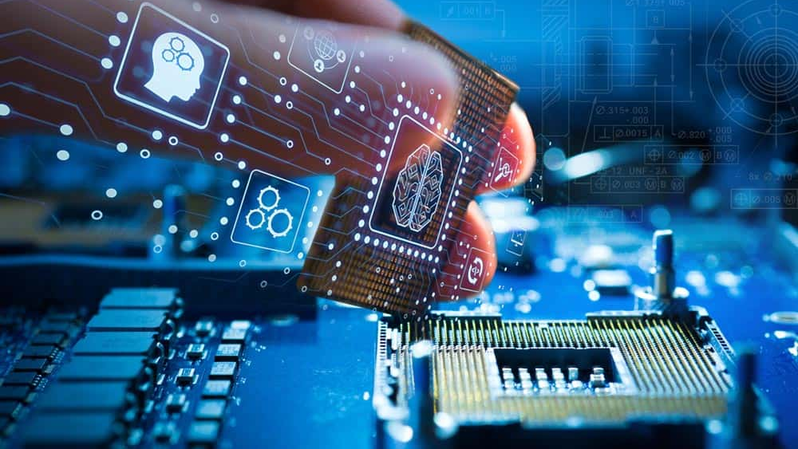

WHAT IS AN
EMBEDDED SYSTEM?
An embedded system is a combination of computer hardware and software designed for a specific function

Slide 43


Role of an embedded system
The Silent Intelligence
The intricate network of embedded systems silently orchestrating modern technology, enhancing efficiency, and automating everyday tasks.
The Nervous System of IoT
Serving as the neural network, embedded systems play a pivotal role in connecting, sensing, and controlling devices within the vast ecosystem of the Internet of Things.
Bridging the Physical and Digital Realms
Acting as the bridge between the physical and digital worlds, embedded systems seamlessly merge hardware and software to power diverse applications in our connected environment.

Slide 44
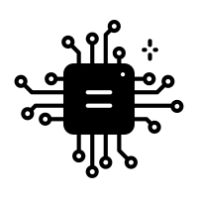

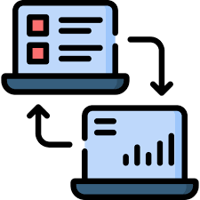

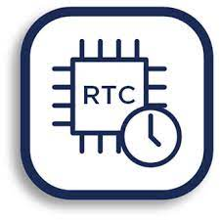
BUILDING BLOCKS
Microcontroller
Central Processor
Memory
Data Storage
Communication
Data Exchange
Sensors/Actuators
Real-time clock
Input perception/output execution
Timing precision

Slide 45
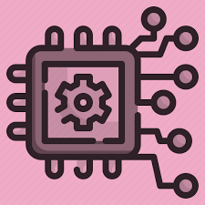
EMBEDDED SYSTEM
SYNERGY OF ELECTRONICS AND EMBEDDED SYSTEMS
Integration of Electronics
Embedded Intelligence
Embedded systems heavily rely on electronic components, including microcontrollers, sensors, and actuators, to perform dedicated functions. Electronics serve as the foundational building blocks for embedded systems, providing the necessary hardware for computation and control.
Electronics empower embedded systems with the intelligence to interact with the surrounding environment. Through the integration of sensors and processing units, electronics enable embedded systems to sense, process, and respond to real-world data, facilitating automation and smart functionalities.

Slide 46
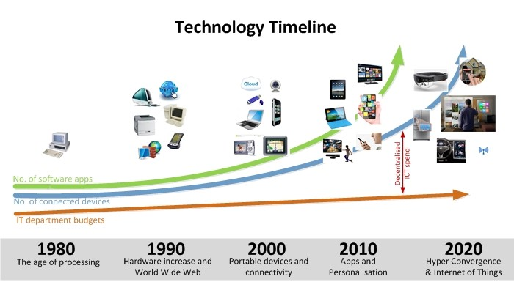
Technology Timeline

Slide 47
Reference Links
https://www.techtarget.com/iotagenda/definition/Internet-of-Things-IoT
https://link.springer.com/article/10.1007/s11036-018-1090-3
https://jasupdates.com/iot/
https://www.slideshare.net/ShreeDevi42/iot-module-1-pptpptx
https://www.hexacta.com/iot-security-mitigating-the-risk-of-an-attack-on-your-system/

Slide 48
THANK YOU.
QUESTIONS?

